Slide 1
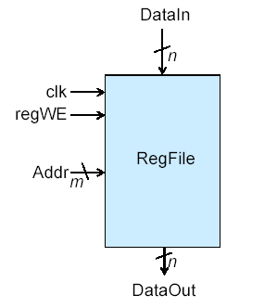
A Typical Register File
Data to be written into a location (word) in the register file; n bits per word
Writes occur on the clock edge (are synchronous), reads are asynchronous
This register holds 2^{m} words (or has 2^{m} locations), each n bits wide
Controls writing of locations (words)
Address that determines which location (word) to read and write; m bits wide
The register capacity (total number of bits it can hold) is 2^{m} * n bits; or equivalently: number of words * width of a word
Data that is read from a register file location (word); n bits per word (n bits wide)

Slide 2
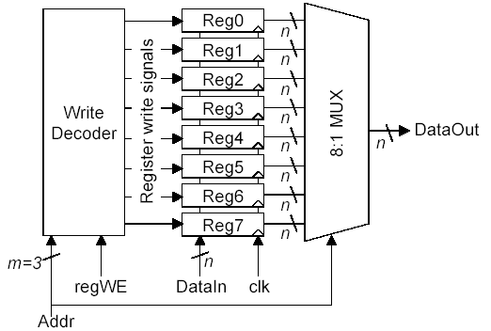
Building a Register File
Loadable Registers
Asynchronous Read, just a MUX
A 3:8 Decoder with enable

Slide 3
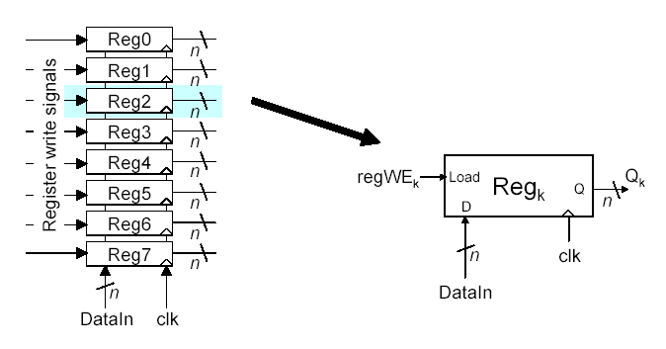
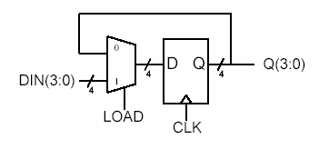
Loadable Register

Slide 4
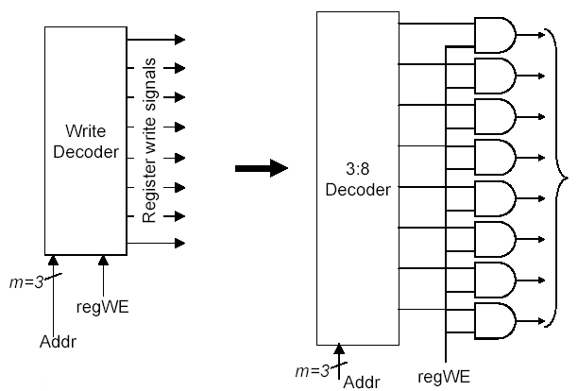
Write Decoder

Slide 5
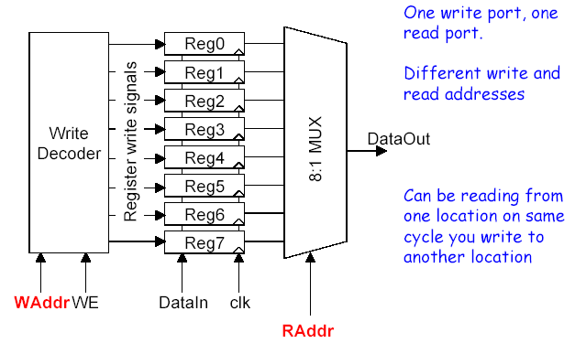
Dual Ported Register File

Slide 6
Multi Ported Register File
3-bit Read Addr A
r0
r1
r2
Write
Decoder
r3
r4
Port A
8:1 MUX
Port B
r5
r6
r7
WE
CLK
3-bit Write Address
Data Input
Port D
3-bit Read Addr B

Slide 8
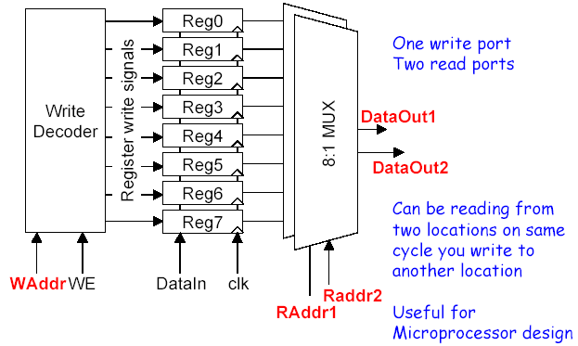
Multi Ported Register File

Slide 9
Memories vs. Register Files
Random Access Memory (RAM) is similar to a register file
  Stores many multi-bit words for reading/writing
RAM usually only single-ported
RAM usually much, much larger
  Megabytes or gigabytes instead of bytes
RAM implementation conceptually the same as register file, however, …
  Uses a capacitor to store the 0 or 1
  Transistor-level implementation very different due to size/usage characteristics

Slide 10
Lab #6
In this assignment you will design a 4-bit by 8 word register file from the ground up
  7 Steps
  Follow each step carefully to make sure you understand how all the pieces fit together

Slide 11
Lab #6
WE
Address
3
Reg0
3
Reg1
Write Decoder
Reg2
Reg3
DataOut
Reg4
Reg5
Reg6
Reg7
Register Write Signals
DataIn
CLK

Slide 12

Backup

Slide 13
Review
1 – Name one of the three major sections of a register file.
(write) decoder, registers, MUX or MUXes
2 – What type of Flip-Flop was used exclusively in Chapter 12?
D
3 – A triple ported register file has how many different address signals?
3

Slide 14
WE
Address
3
Reg0
3
Reg1
Write Decoder
Reg2
Reg3
DataOut
Reg4
Reg5
Reg6
Reg7
Signals:
One bit wide:
Four bits wide:
Register Write Signals
DataIn
CLK

Slide 15
Lab #6
Reg0
Reg1
Reg2
Reg3
Output
Reg4
Reg5
Reg6
Reg7
Address

Slide 16
Shift Registers
Uses of shift registers
  Delaying a serial stream by some # of cycles
    This is done in Xilinx FPGAs to account for signal skew. If you know some bits of a bus signal are coming in slower than others, you can delay the ones that get there sooner

Slide 17
Alternate Representation?
Serial-In, Q2, Q1
0
1
D Q
3
Q2, Q1, Serial-Out
D2, D1, D0
3
3
3
ENABLE
CLK
Alternate representations

Slide 18
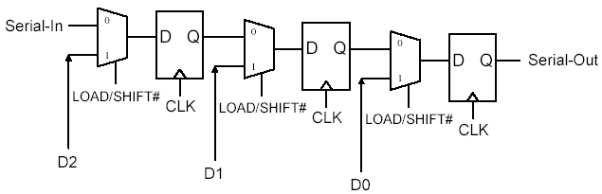
A SISO With An Enable
Serial-In, Q2, Q1
0
1
D Q
3
Q2, Q1, Serial-Out
D2, D1, D0
3
3
3
ENABLE
CLK
FF2
FF1
FF0
Alternate representations

